Slide 1
Predict Severity of Casualties of Car Accident Victims in the UK Using Decision Tree Classifier and K-Modes Clustering
Lim Zhong Han 147241
Ng Wei Yi 147630
Yeoh Jocelyn 154696

Slide 2
Problem Statement

Slide 3
Dataset
Context
Problem statement
The dataset is taken from the United Kingdom’s government website https://data.europa.eu/data/datasets/road-traffic-accidents/?locale=en. Leeds City Council collects the road traffic accidents across Leeds from the year 2019.
This dataset contains 1907 accidents happened in UK.
1907 rows
18 columns
Data includes accident dates, road classes, number of vehicles involved, road surface, lighting conditions, weather conditions, type of vehicles and severity of any casualties.
An analysis to predict the severity of casualties with respect to the road surface, lighting conditions and weather conditions in Leeds.

Slide 4
Objectives

Slide 5
Objective 1
Objective 2
Recognize certain key factors that affect the severity of casualties of car accidents.
Choose the best machine learning model to build a champion model to predict the severity of casualties of car accident victims in the UK.

Slide 6
Data Preprocessing

Slide 7
Load packages
Set working directory
Convert attributes, select columns and check null values
“ggplot2”
System for declaratively creating graphics, based on The Grammar of Graphics.
“dplyr”
structure of data manipulation that provides a uniform set of verbs, helping to resolve the most frequent data manipulation hurdles.
“lattice”
Graphics and data visualization package.
“scatterplot3d”
For the visualization of multivariate data in a three dimensional space.
Read the CSV file using read.csv() function.
Use str() function to display the internal structure of the dataset.
Use summary() function to display the summary of the imported dataset.
Use as.factor() function to convert the attributes of Road.Surface, Lighting.Conditions, Weather.Conditions and Casualty.Severity to factor.
Use dataframe[, c()] function to select specific columns by names.
Use sum(is.na()) function to determine whether there are null values in Road.Surface, Lighting.Conditions, Weather.Conditions and Casualty.Severity.

Slide 8
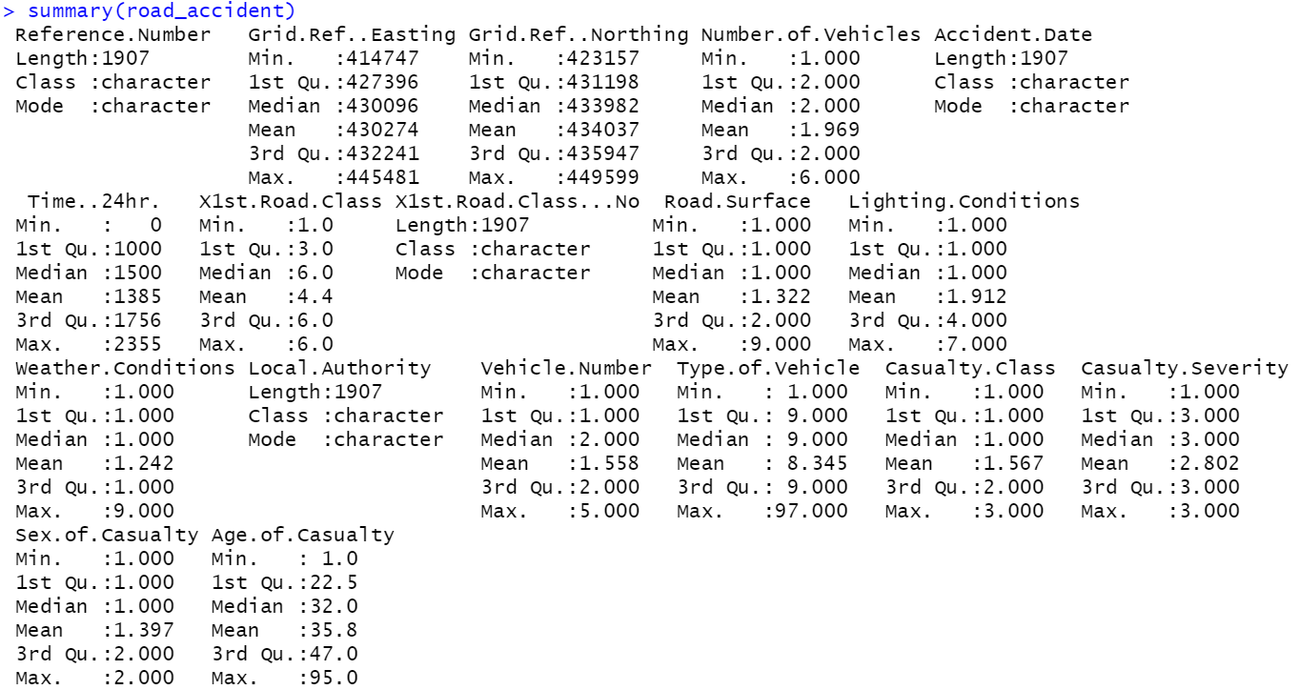
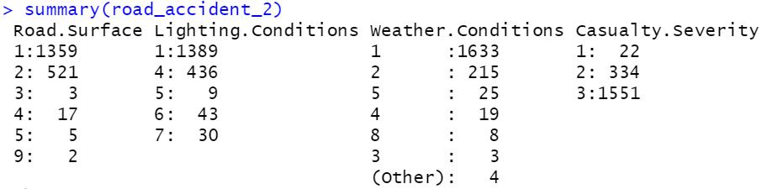
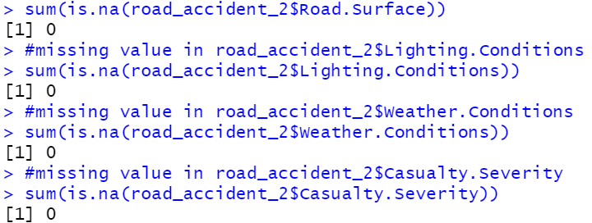
Display the summary of the imported dataset.
summary()
Convert the attributes to factor.
as.factor()
To determine whether they are null values.
sum(is.na())

Slide 9
Remove outliers and convert attributes
Plot 3D scatterplot and scatterplot matrix
Plot histograms then convert attributes
Use subset() function to remove the outliers, Weather.Conditions == 8 and Weather.Conditions == 9 from Weather.Conditions and Lighting.Conditions == 3 and Lighting.Conditions == 7 from Lighting.Conditions.
Convert the attributes of Road.Surface, Lighting.Conditions, Weather.Conditions and Casualty.Severity to numeric in order to plot the 3D scatterplot and the scatterplot matrix.
Use scatterplot3d() function to plot the 3D scatterplot.
Use splom() function to plot the scatterplot matrix.
Use ggplot2 library to plot the histograms of Road.Surface, Lighting.Conditions, Weather.Conditions and Casualty.Severity
Convert the attributes of Road.Surface, Lighting.Conditions, Weather.Conditions and Casualty.Severity back to factor using as.factor() function

Slide 10
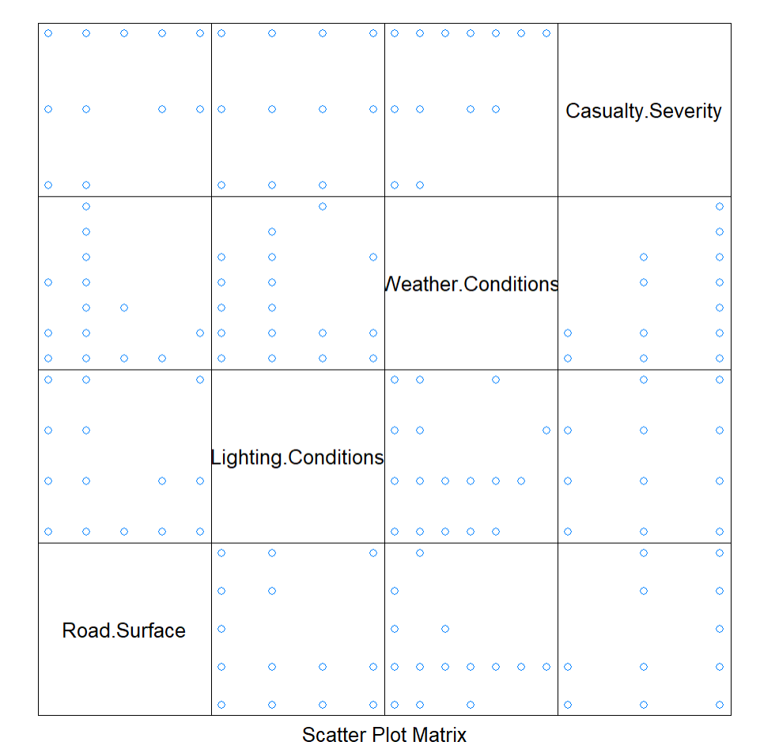
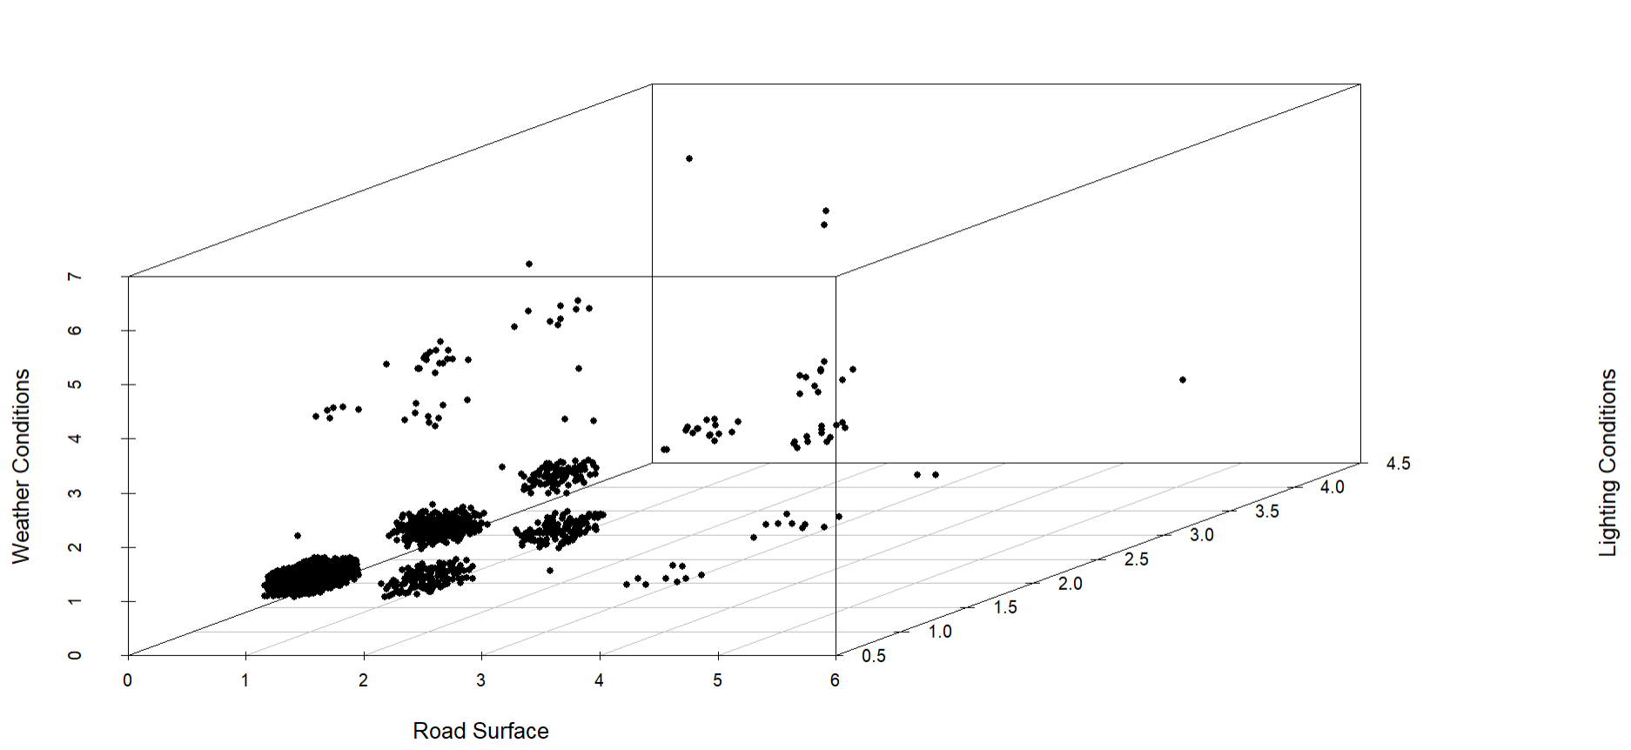
3D Scatterplot and Scatterplot Matrix

Slide 11
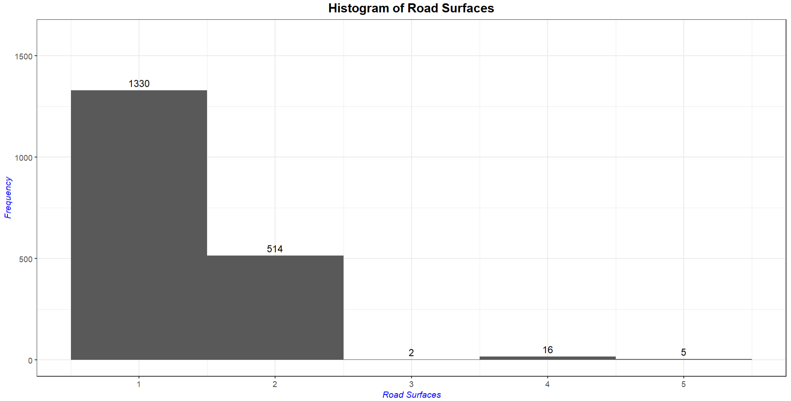
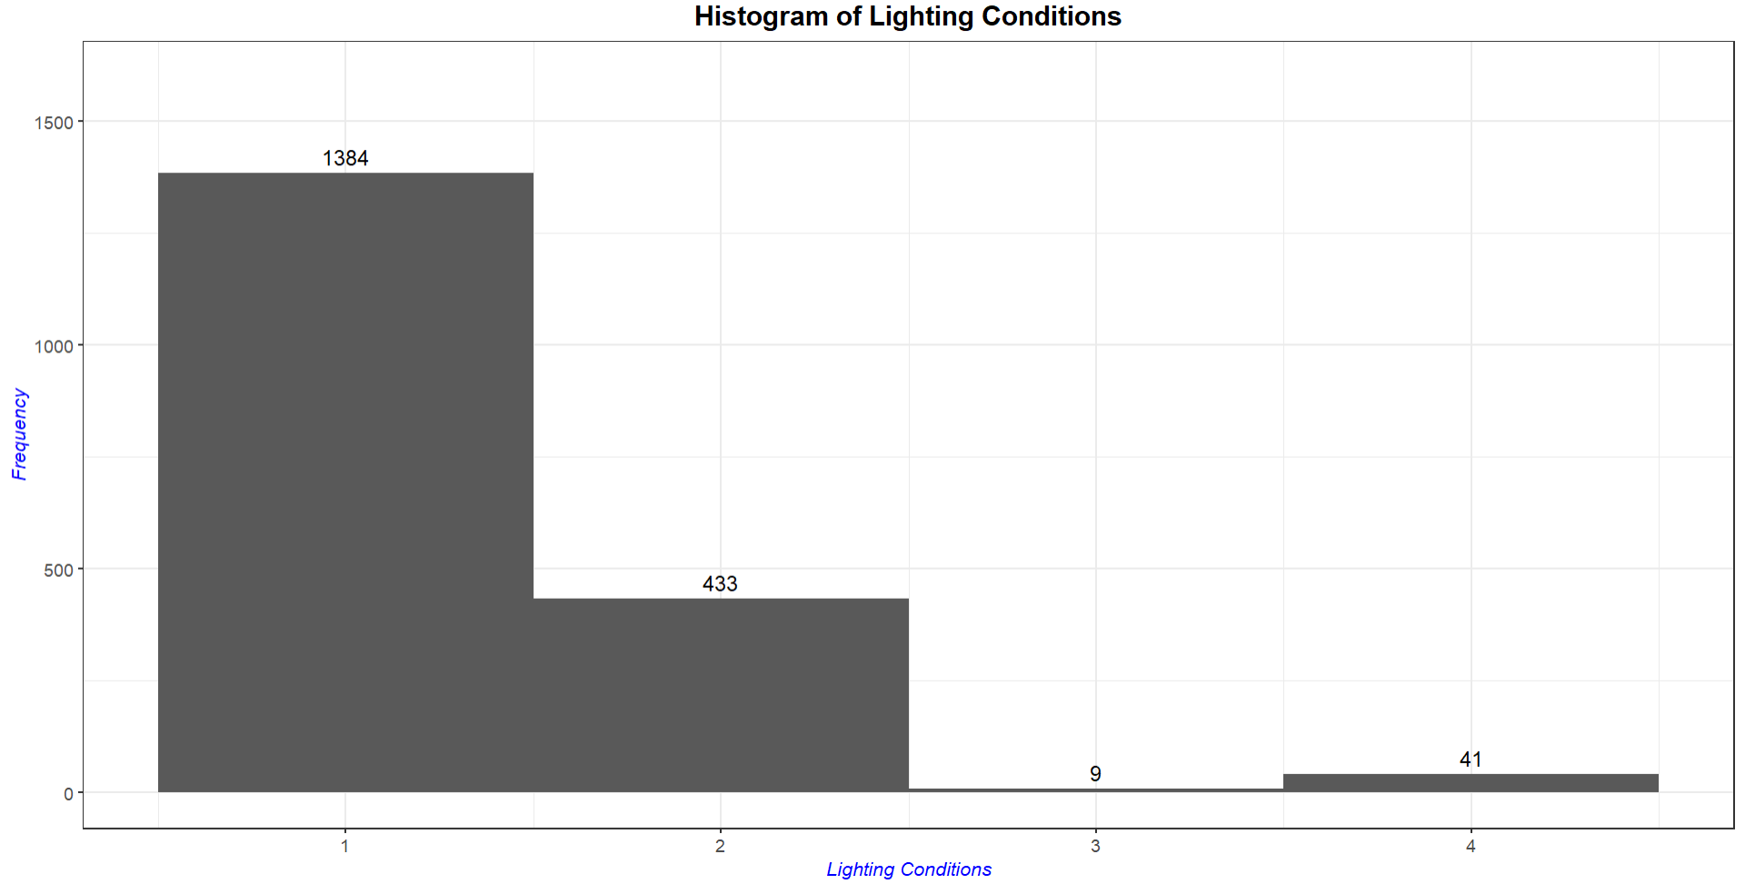
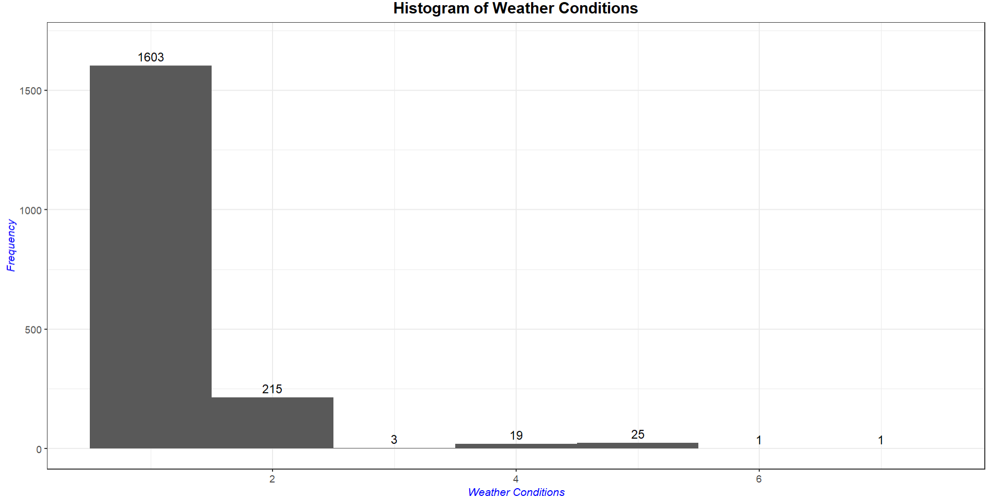
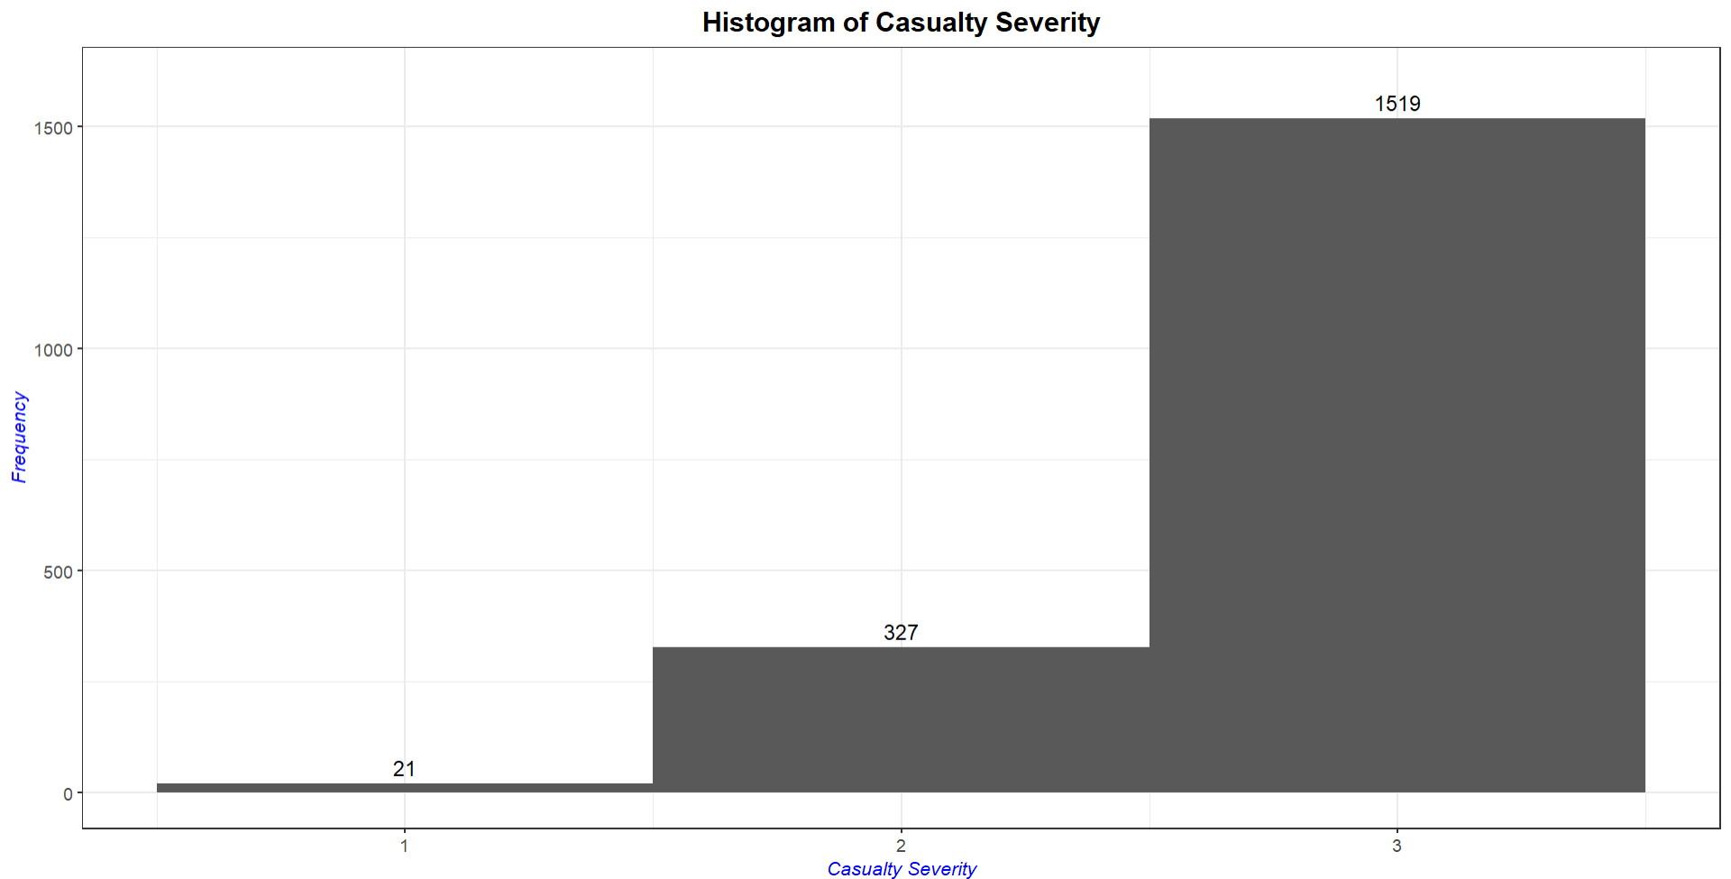
Histograms

Slide 12
Machine Learning Models

Slide 13
Algorithms
Dataset
Road Traffic Accidents in UK
Unsupervised
Supervised
Clustering
Classification
K-modes
Decision Tree Classifier

Slide 14
K-modes Clustering

Slide 15
K-modes algorithm - to cluster categorical variables
Step 1 : Initialization.
Select the k initial mode.
Step 2 : Allocation.
Allocate the observations to the closest cluster based on a simple dissimilarity measure. Update each cluster mode after each allocation.
Step 3 : Assignment.
After all the observations have been allocated to a cluster, check the dissimilarity value of each observation against the mode.
Step 4 : Iteration.
Repeat Step 3 until none of the observations change to another clusters.

Slide 16
K-modes Coding
Load packages
Set seed
K-modes clustering
Confusion Matrix
“klaR”
Perform K-modes clustering algorithm.
“caret”
Generate confusion matrix for model evaluation.
Within a ‘for’ loop
Generate a range of 10 data values.
Obtain a fairly good and precise result.
Apply “kmodes” function
kmodes(
data, modes,
iter.max = 10, weighted=FALSE, fast=TRUE)
Apply “confusionMatrix” function
confusionMatrix(data)
Extract overall “Accuracy” value and append all of them into “accuracy_score()” vector.

Slide 17
kmodes function
“road_accident_3” data that has been converted to factor attributes.
Whether a fast version of the algorithm should be applied.
The maximum number of iterations allowed.
data
modes = 3
iter.max = 10
weighted
= FALSE
fast = TRUE
A set of the distinct cluster modes that appear most often.
Whether usual simple-matching distance between objects or a weighted distances is used.
Set as FALSE: within-cluster simple-matching distance for each cluster.

Slide 18
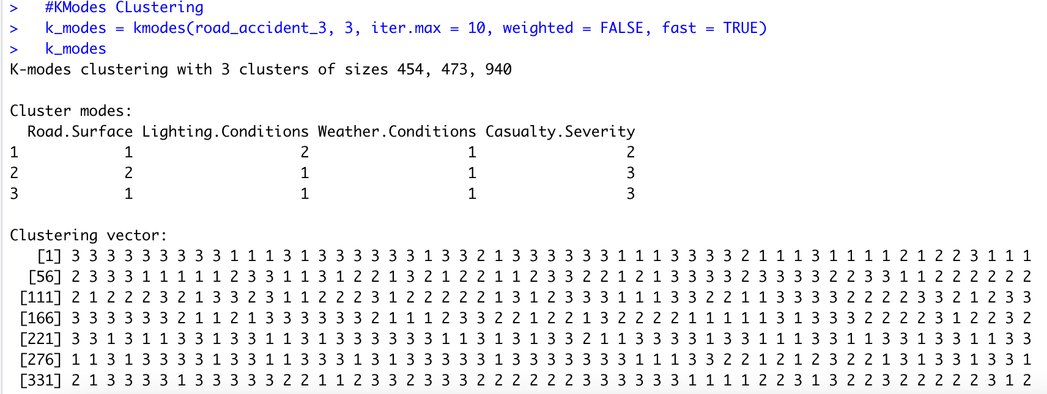
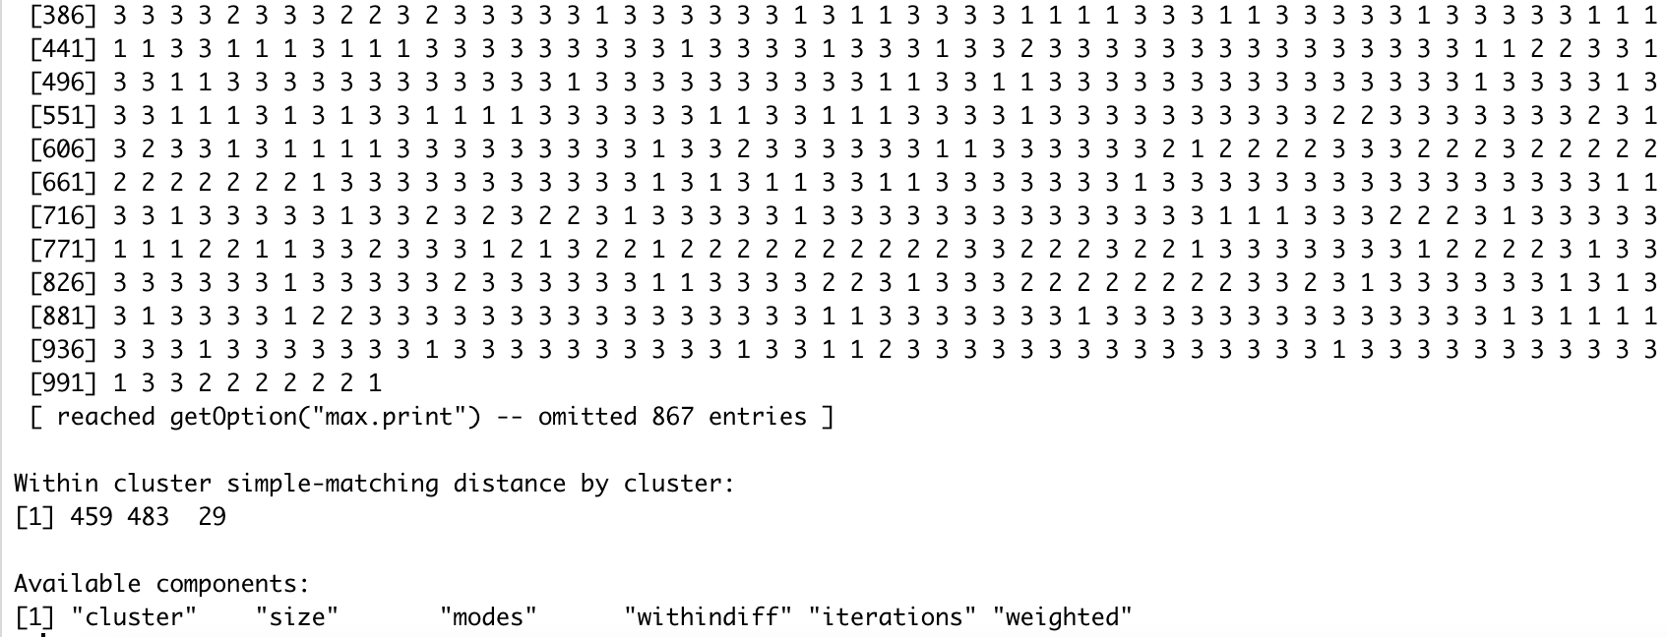
K-modes result
kmodes(road_accident_3, 3,
iter.max = 10,
weighted = FALSE,
fast = TRUE)
There are 454 objects in cluster 1, 473 objects in cluster 2 and 940 objects in cluster 3.
Cluster modes shows that the numbers that often appear in each cluster for each variable.
Within cluster simple-matching distance by cluster is the average of distance for each data with the center of cluster.

Slide 19
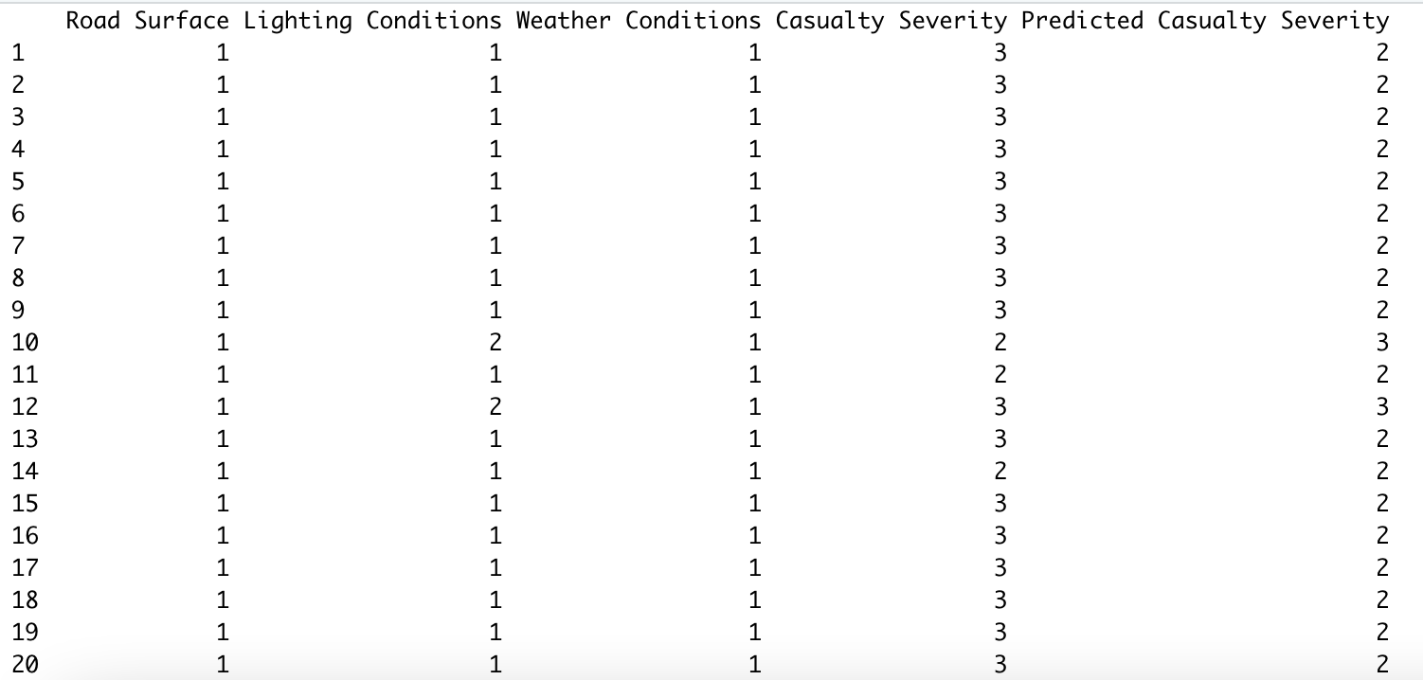
K-modes table
Shows the cluster for each objects.
This table can be shown by using “cbind” function.
“cbind” forms a matrix by joining the Predicted Casualty Severity with the existing k-modes table.

Slide 20
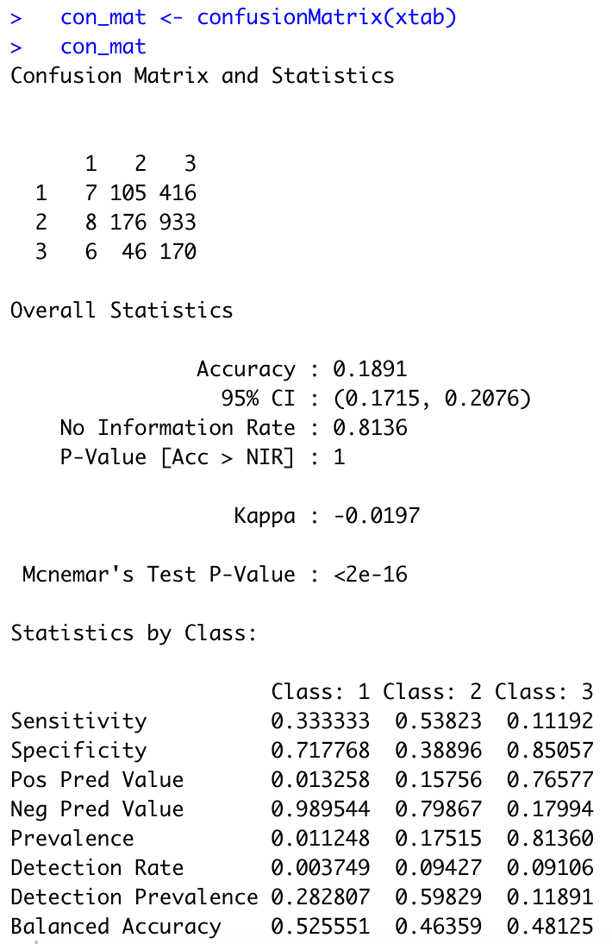
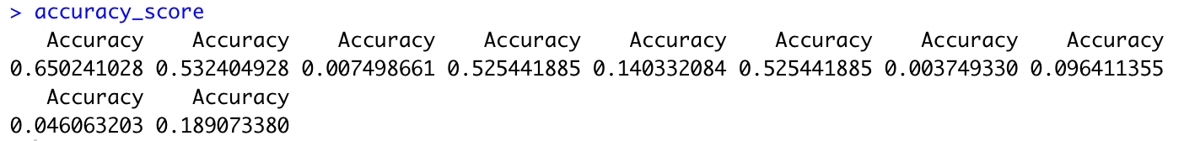
confusionMatrix function
“xtab” data with the prediction and actual values obtained from “kmodes_table”.
data
Extract “Accuracy” value from the Overall Statistics and append them.
Accuracy score
Average Accuracy Score = 0.2716658

Slide 21
Decision Tree Classifier

Slide 22
Decision Tree Classifier
A type of supervised machine learning algorithm
Has a flowchart like structure
Maps the possible outcomes of a series of related choices
Notes:
If an observation turns out that the closest mode is in another cluster, move the observation to the appropriate cluster and update the mode of both clusters.

Slide 23
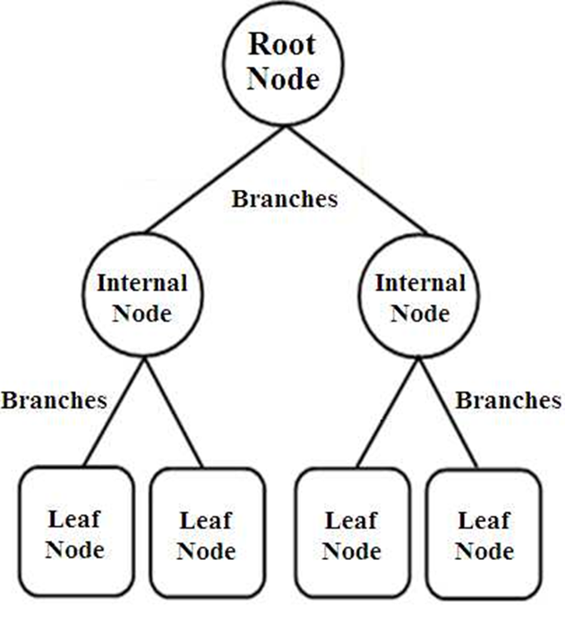
Root node
The first node of the tree
Branches
Alternative outcome for each node
Internal node
A point where a decision will be made
Leaf node
Final node at the last branch of the tree

Slide 24
rpart function
“Train-dataset” data that has been converted to factor attributes.
The minimum number of observations in any terminal node
Set attribute selection parameter as gini index
data
minsplit = 1
minbucket = 1
cp = 0.001
parms=list(split='gini')
The minimum number of observations that must exist in a node in order for a split to be attempted
Control parameter - set low value to allow more splits

Slide 25
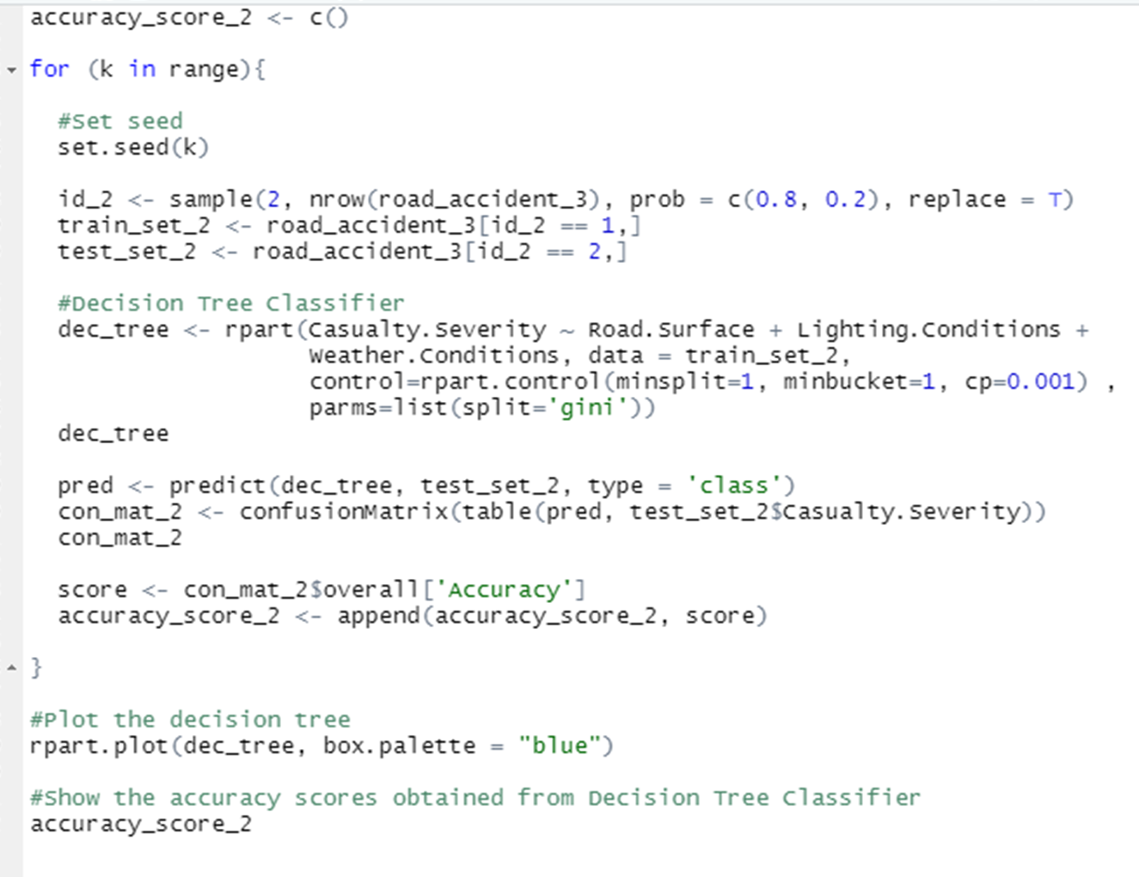
Decision Tree Coding
Split the data into train and test datasets in ratio 8:2
Perform the decision tree classifier on train dataset and test it on the test dataset
Visualize the decision tree for one of the seeds

Slide 26
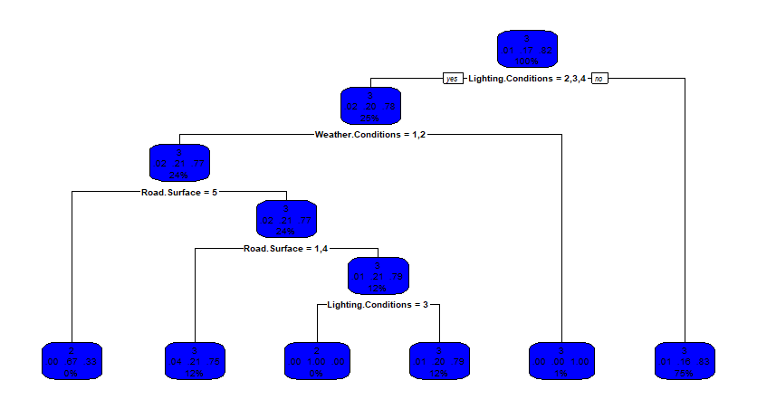
Decision Tree Classifier Visualization

Slide 27
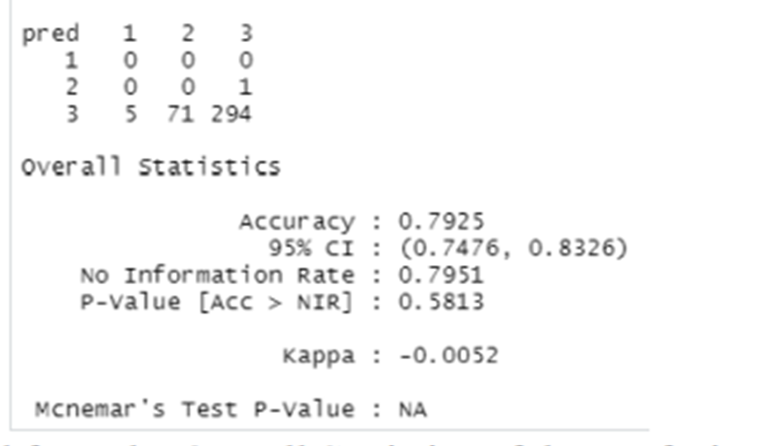
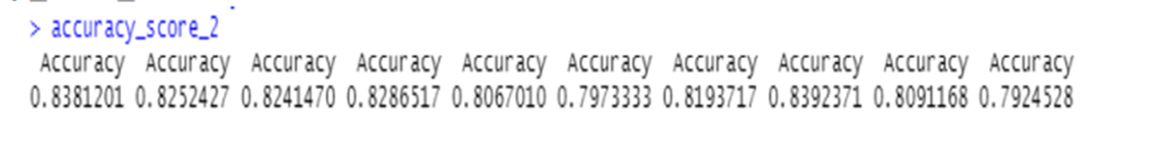
confusionMatrix function
Confusion matrix
data
Extract “Accuracy” value and append them.
Accuracy score
Average Accuracy Score = 0.8180374

Slide 28
Hypothesis Testing

Slide 29
H0 (Null Hypothesis)
H1 (Alternative Hypothesis)
There is no significant difference between the mean of accuracy of the K-modes Clustering model and the accuracy of the Decision Tree Classifier model.
There is a significant difference between the mean of accuracy of the K-modes Clustering model and the accuracy of the Decision Tree Classifier model.

Slide 30
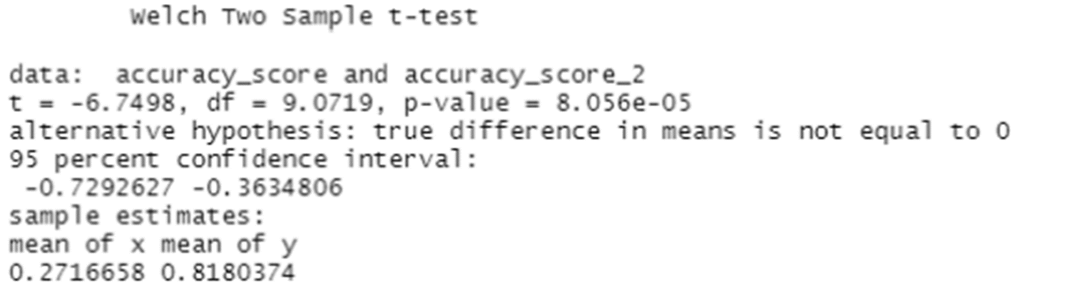
Welch’s T-test
Welch’s T-test Result
Compare the mean of two populations
Can be used on data with unequal variance
p-value < 0.05 , null hypothesis is rejected
t is negative, the accuracy for the K-modes clustering model is less than the Decision Tree Classifier model

Slide 31
Conclusion

Slide 32
Comparison
K-modes clustering
Decision tree classifier
•The classifier model performs better than the clustering model.
•Clustering performs poorly for discrete data and the results for K-modes model are also inconsistent.
•The Decision Tree model accurately predicts the casualty severity level with an average accuracy of 81.8%.

Slide 33
Problems and Pitfalls

Slide 34
Visualize Decision Tree Classifier
Applied Hypothesis Testing on wrong variables
Deciding which Hypothesis Testing to be used
There was only one node that appeared in the output when trying to visualize the Decision Tree Classifier using rpart.plot() function. The control parameters must be lowered for the decision tree because the default parameters are too high so it does not split.
Hypothesis Testing was applied on the wrong variable, which was the data although the variable chosen to do testing on is the mean accuracies of two different machine learning models.
There are many different tests such as ANOVA test, student’s t-test and Welch's t-test that can be used. Eventually, settled on Welch's t-test as it is the most suitable Hypothesis Test for this project.

